Slide 1
FLIGHT PRICE PREDICTION
SUBMITTED BY – AMAN KUMAR PATEL
Batch – internship 25
Sme – md. kashif

Slide 2
INTRODUCTION
• Business Problem Framing
Anyone who has booked a flight ticket knows how unexpectedly the prices vary. The cheapest available ticket on a given flight gets more and less expensive over time. This usually happens as an attempt to maximize revenue based on - 1. Time of purchase patterns (making sure last-minute purchases are expensive) 2. Keeping the flight as full as they want it (raising prices on a flight which is filling up in order to reduce sales and hold back inventory for those expensive last-minute expensive purchases)
• Conceptual Background of the Domain Problem
Airline companies use complex algorithms to calculate flight prices given various conditions present at that particular time. These methods take financial, marketing, and various social factors into account to predict flight prices. Nowadays, the number of people using flights has increased significantly. It is difficult for airlines to maintain prices since prices change dynamically due to different conditions. That’s why we will try to use machine learning to solve this problem. This can help airlines by predicting what prices they can maintain. It can also help customers to predict future flight prices and plan their journey accordingly

Slide 3
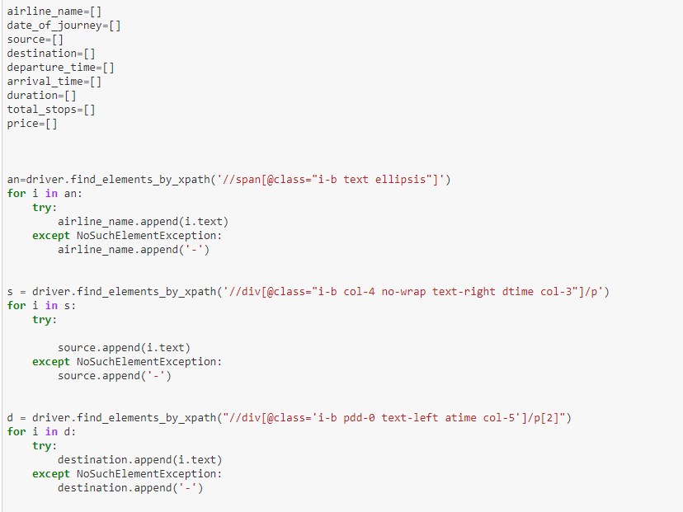
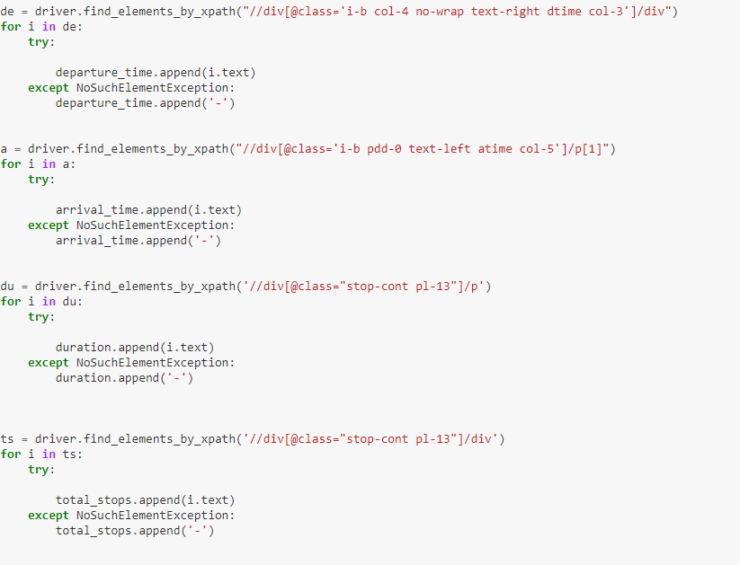
DATA COLLECTION USING WEB SCRAPING
I have used here selenium for web scraping

Slide 4
Exploratory data analysis
As a first step I have imported required libraries and I have imported both the datasets which were in csv format
Then I did all the statistical analysis like checking shape, nunique, value counts, info etc…..
While checking the info of the datasets I found some columns with more than 0% null values .
Then while looking into the value counts I found some columns with more than values this also creates skewness in the model and there are chances of getting model bias so I have dropped those columns.

Slide 5
Exploratory data analysis
First of all I checked all of my dataset, and I found very easy Like shape, and the types of columns and also I checked info of columns . and I dropped some columns there. And while checking null values , I found null values in some columns and I removed all of my null values with the help of imputation method.
And after that I dropped two columns , 1st one was ID and the 2nd one was UTILITIES .. Because while I was checking the unique values then I found the that two columns is having all unique values and as we also know all in id there is always particular asset. So , I decided to drop these two columns.
Now after the checking of unique values I did take as a part of feature extraction I converted all of the year columns in respective age
and also that all process done in both dataset train and test dataset separately , because we had to maintain all of data equally otherwise we will get error.
.

Slide 6
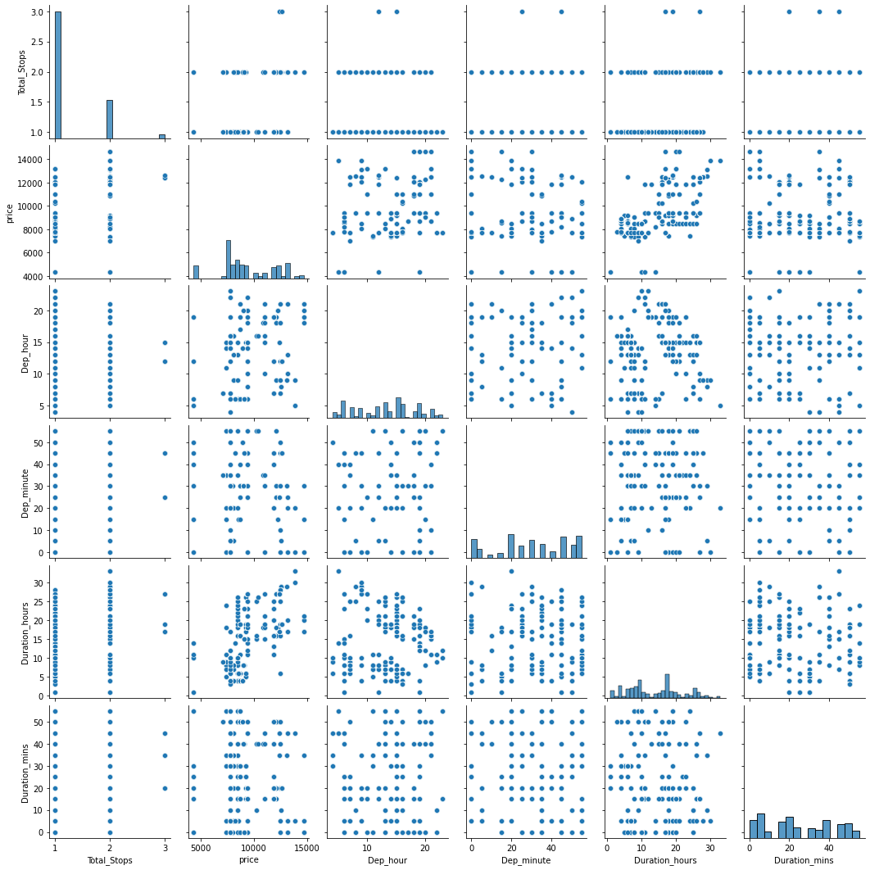

Slide 7
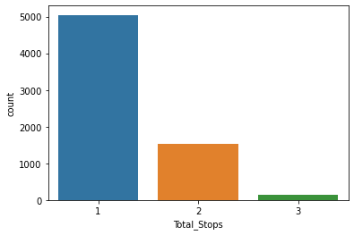
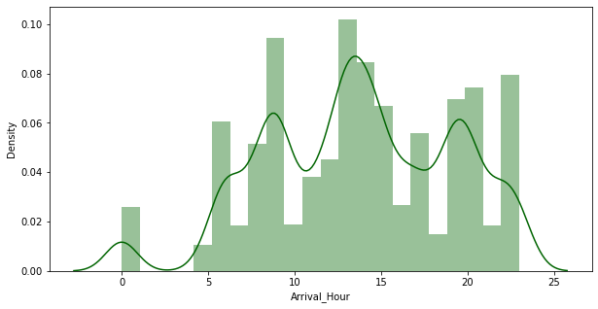
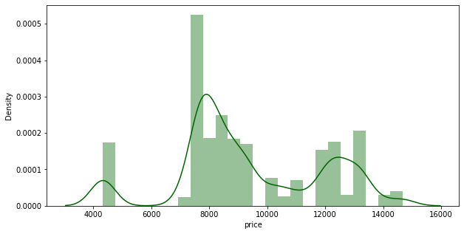
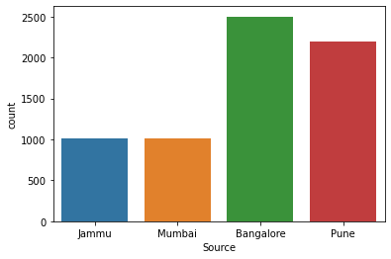
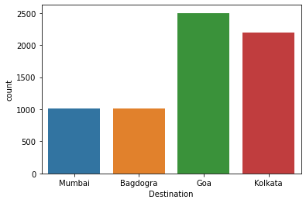
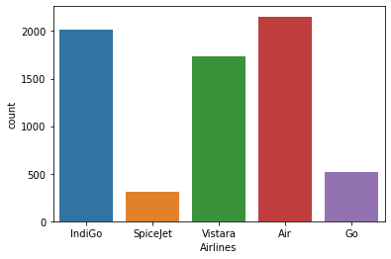

Slide 8
Observation
1-Mostly people use to take a flight who has only one stop
3-ANd only apparox 1500 people use to take 2 stop flights
4-ANd there are very less people who used to take 3 stops or 4 stops flight
1-Mostly Source has banglore as high count
2-after banglore pune has 2nd high count
3-and at least jammu and mumbai equal count

Slide 9
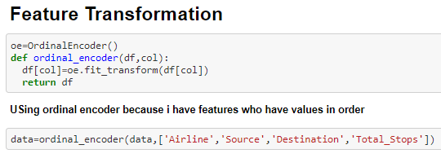
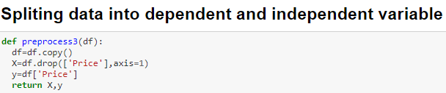
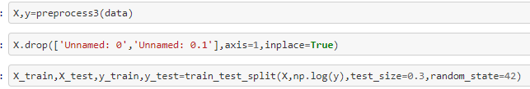
PREPARAING DATA FOR MACHINE LEARNING
OBSERAVTION-
Here I am using ordinal encoder because my features are in order
And I am splitting my data into x,y for train test split

Slide 10
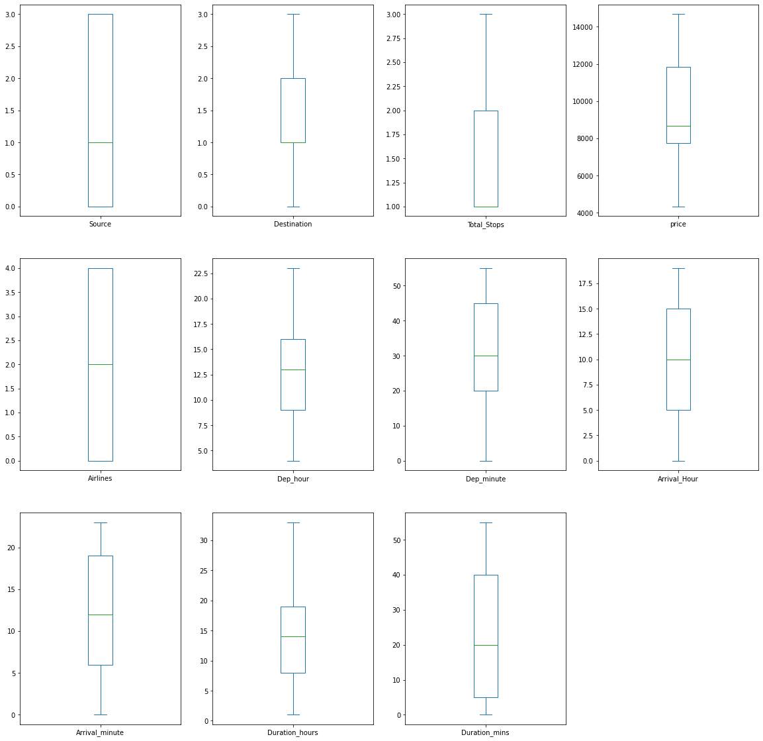
CHECKING OUTLIERS
OBSERVATION-
there is no outliers because every column is categorical we don't have any continuous column in X

Slide 11
Model Building:
Since SalePrice was my target and it was a continuous column so this perticular problem was regression problem. And I have used all regression algorithms to build my model. By looking into the difference of r2 score and cross validation score I found GradientBoostingRegressor as a best model with least difference. Also to get the best model we have to run through multiple models and to avoid the confusion of overfitting we have go through cross validation. Below are the list of regression algorithms I have used in my project.
RandomForestRegressor
ExtraTreesRegressor
GradientBoostingRegressor
DecisionTreeRegressor

Slide 12
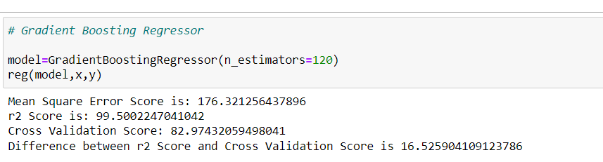
I have already mentioned I have used GRADIENTBOOSTINGREGRESSOR as a best model , becaues it is giving me best accuracy as compare to another algorithm.

Slide 13
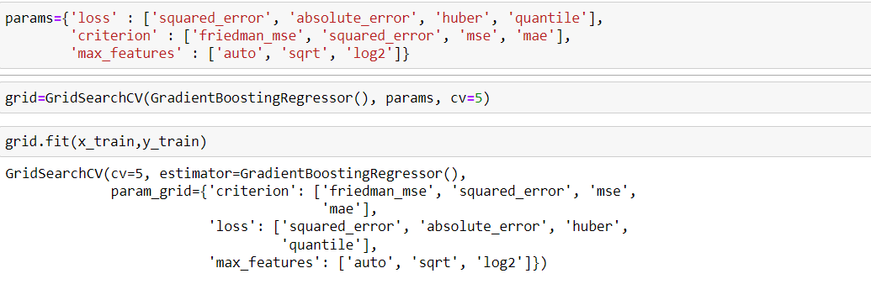
HYPER PARAMETER TUNNING:
I have choosed all parameters of GradientBoostingRegressor, after tunning the model with best parameters I have incresed my model accuracy from Also mse and rmse values has reduced which means error has reduced

Slide 14

Saving model
I have predicted the flightPrice for test dataset using saved model of train dataset, and the predictions look good. I have also saved my predictions for further analysis.

Slide 15
CONCLUSION
Learning Outcomes of the Study in respect of Data Science
The above research will help our client to study the latest flight price market and with the help of the model built he can easily predict the price ranges of the flight, and also will helps him to understand Based on what factors the fight price is decided.
Limitations of this work and Scope for Future Work
The limitation of the study is that in the volatile changing market we have taken the data, to be more precise we have taken the data at the time of pandemic and recent data, so when the pandemic ends the market correction might happen slowly. So based on that again the deciding factors of the might change and we have shortlisted and taken these data from the important cities across india, if the customer is from the different city our model might fail to predict the accuracy prize of that flight.

Slide 16

THANK
YOU

